Slide 1
Exploratory Data Analysis (EDA)

Slide 2
IMPORTANCE OF EDA
Identifying the most important variables/features in your dataset.
Testing a hypothesis or checking assumptions related to the dataset.
To check the quality of data for further processing and cleaning.
Deliver data-driven insights to business stakeholders.
Verify expected relationships actually exist in the data.
To find unexpected structure or insights in the data.

Slide 3
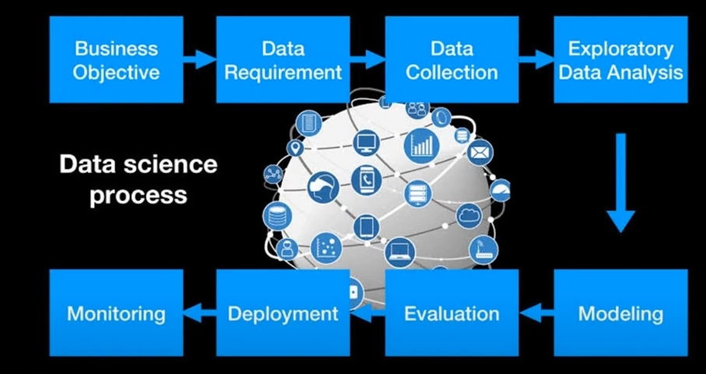

Slide 4
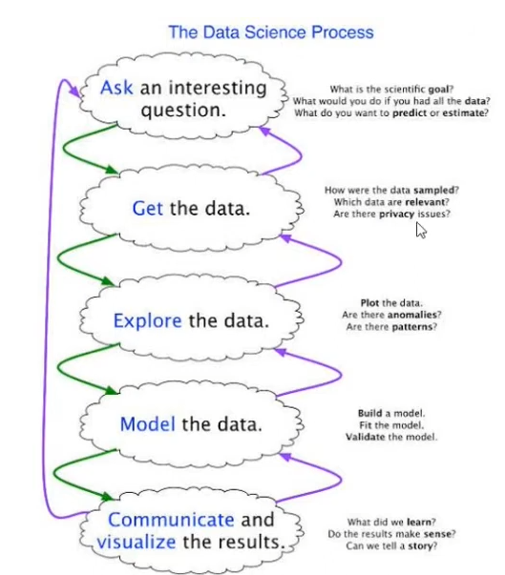

Slide 5
Two Categories of Data
Structured Data types
Example: csv file, excel file, database file
Unstructured Data types
Examples: text, Images, videos, audio,

Slide 6
Major Types of Data
• Numerical
• Categorical
• Ordinal

Slide 7
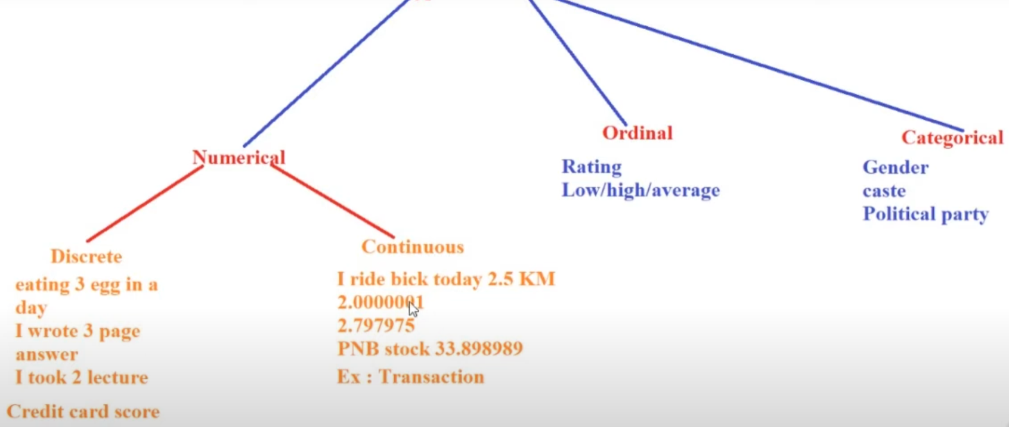
Types of Data

Slide 8
Numerical
• Represents some sort of quantitative measurement
Heights of people, page load times, stock prices, etc.
• Discrete Data
Integer based; often counts of some event.
• How many purchases did a customer make in a year?
• How many times did I flip "heads"?
• Continuous Data
• Has an infinite number of possible values
• How much time did it take for a user to check out?
• How much rain fell on a given day?

Slide 9
Categorical
• Qualitative data that has no inherent mathematical meaning
• Gender, Yes/no (binary data), Race, State of Residence, Product Category, Political Party, etc.
• You can assign numbers to categories in order to represent them more compactly, but the numbers don't have mathematical meaning

Slide 10
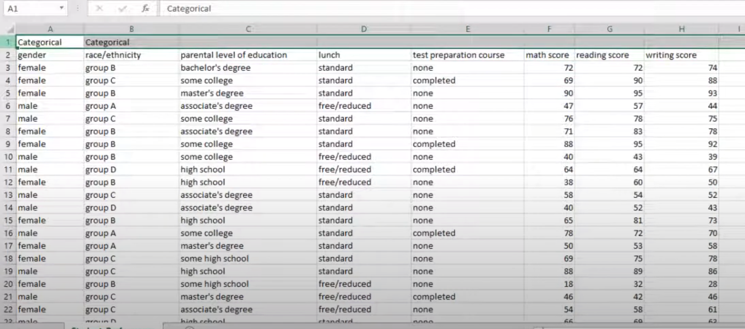

Slide 11
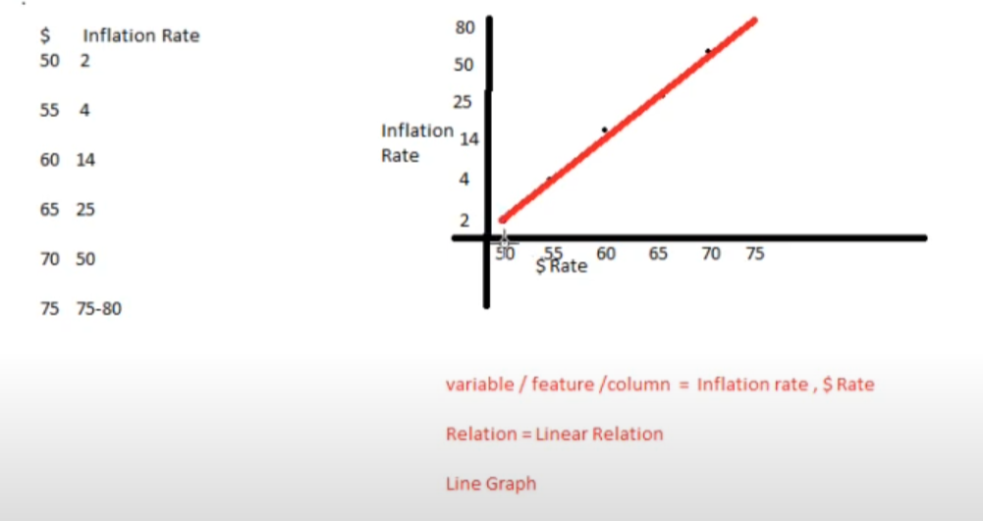

Slide 12
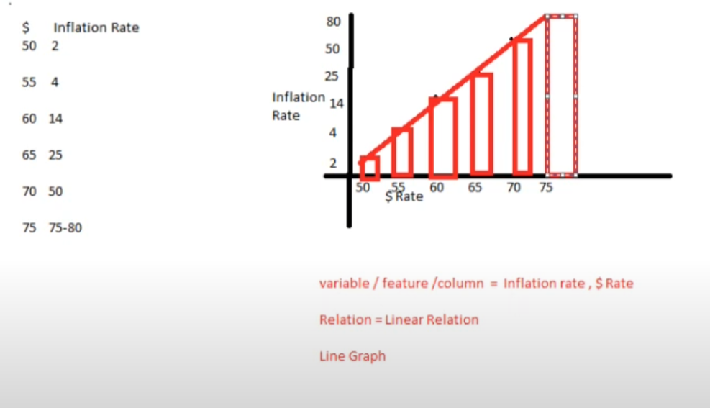

Slide 13
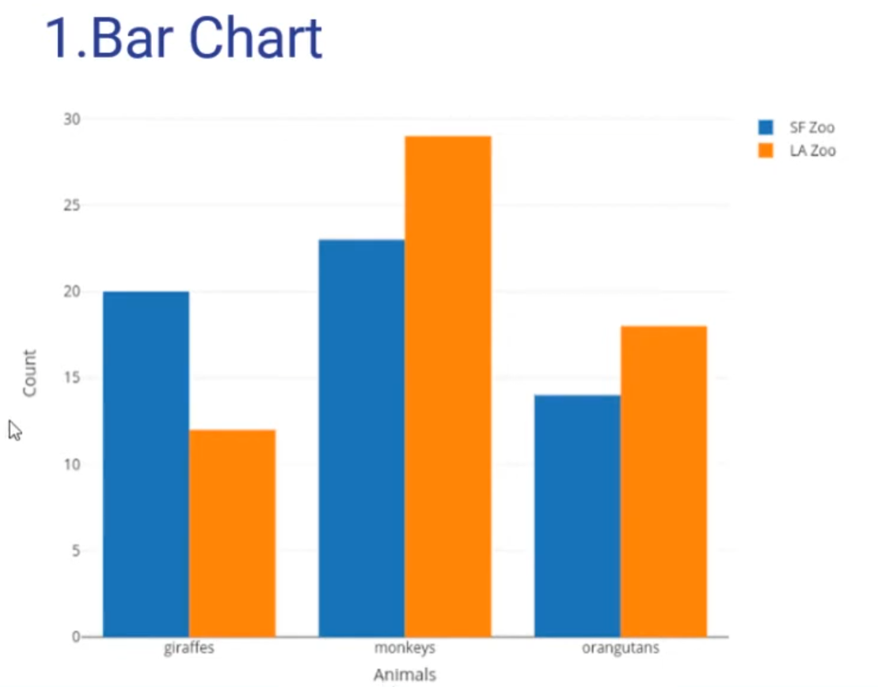
Types of Graphs

Slide 14
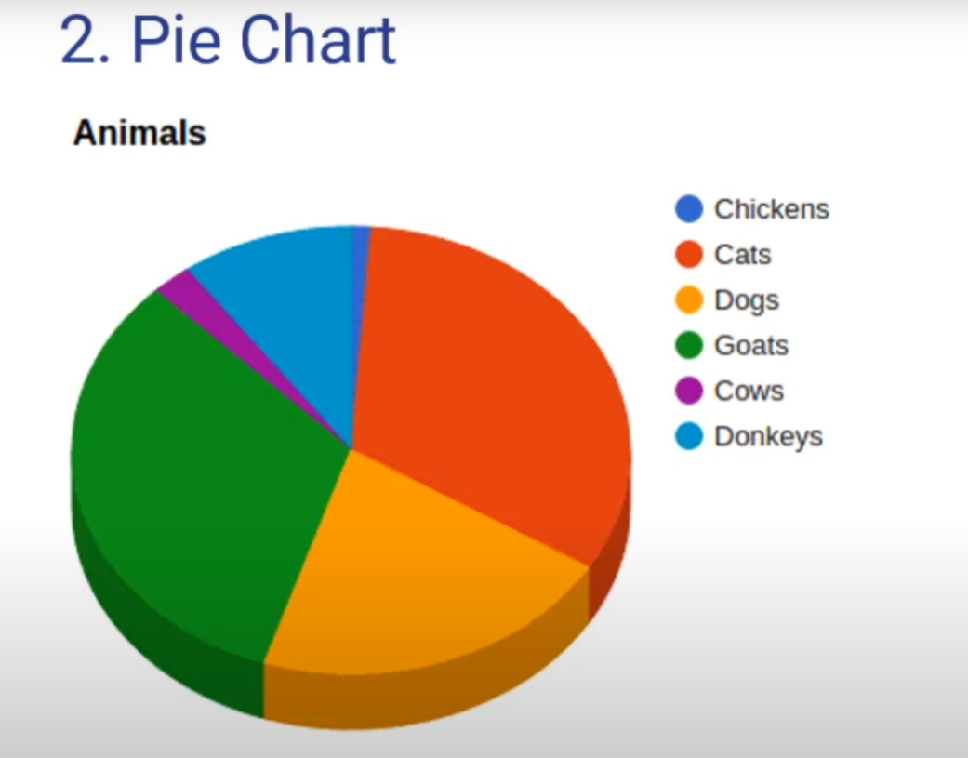

Slide 15
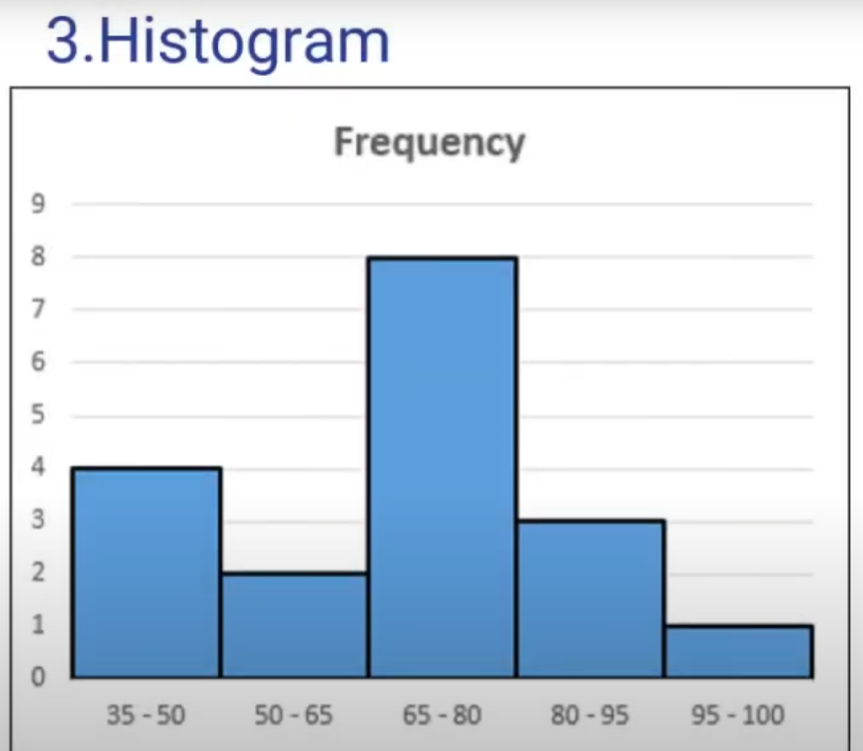

Slide 16
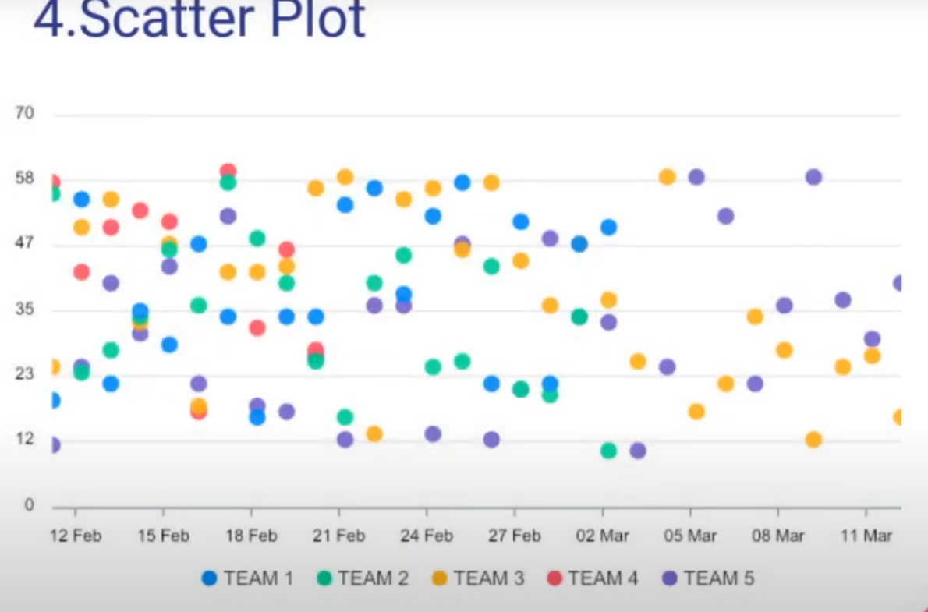

Slide 17
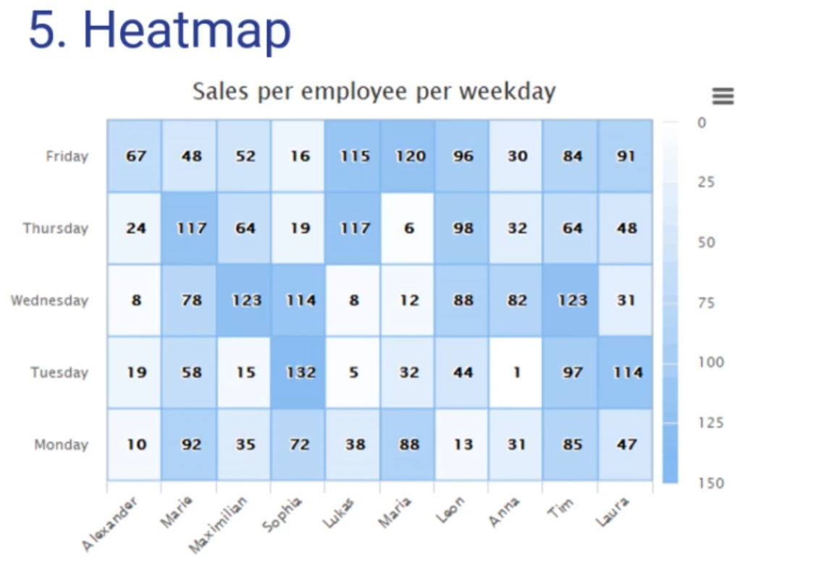

Slide 18
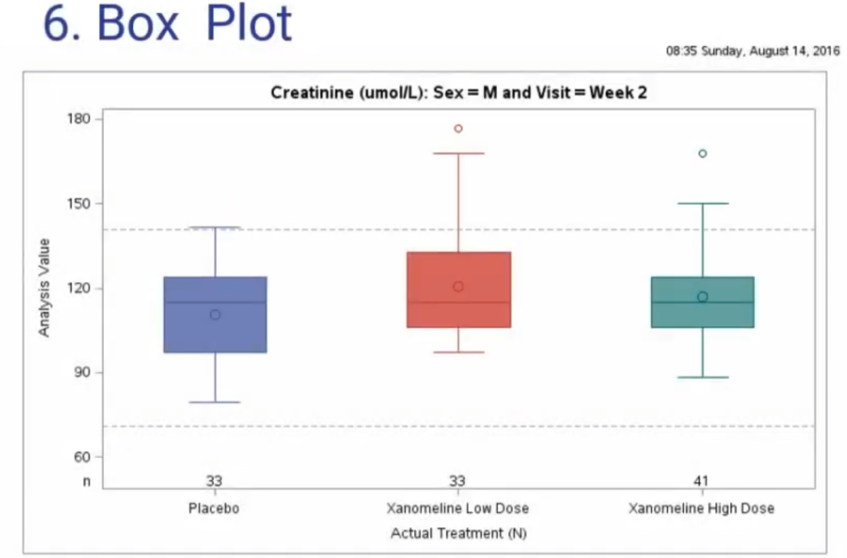

Slide 19
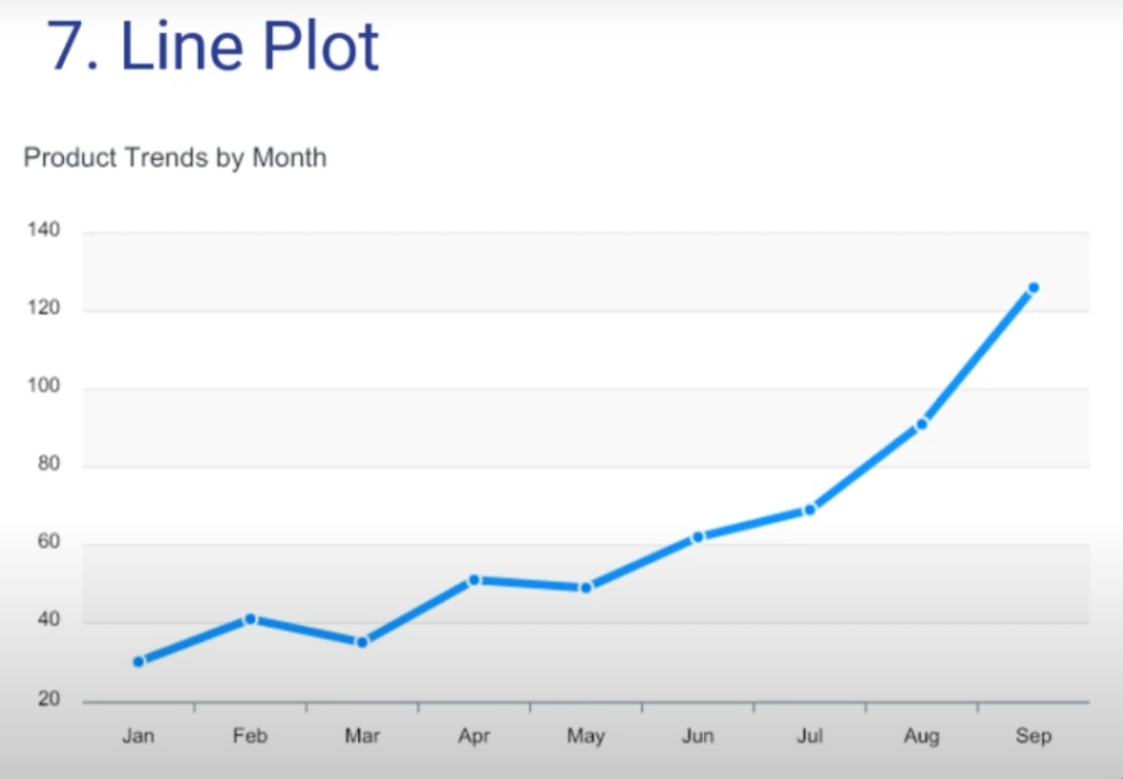

Slide 20
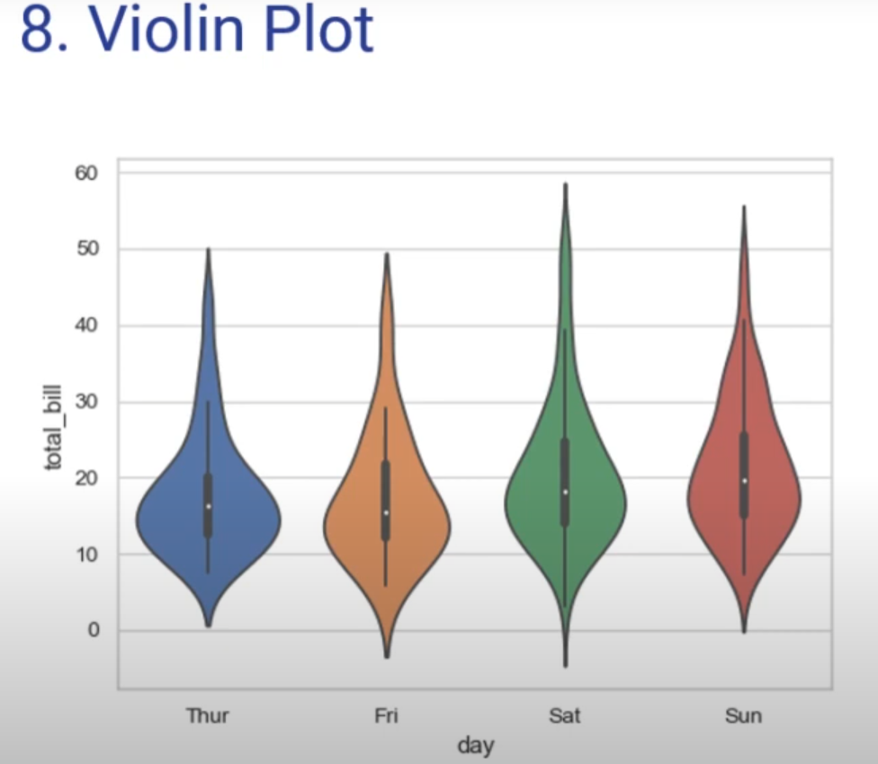

Slide 21
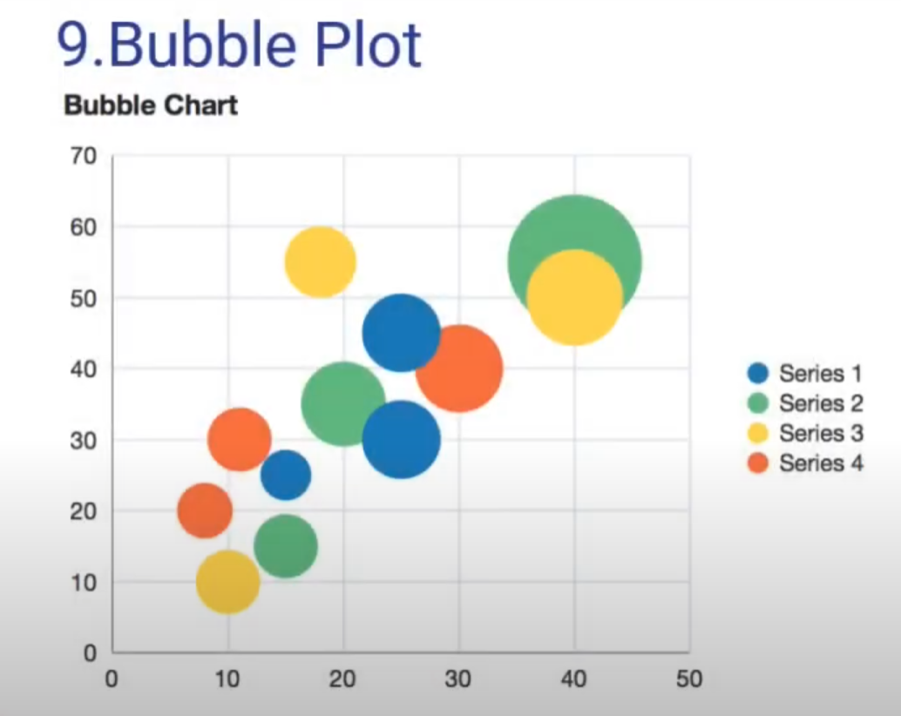

Slide 22
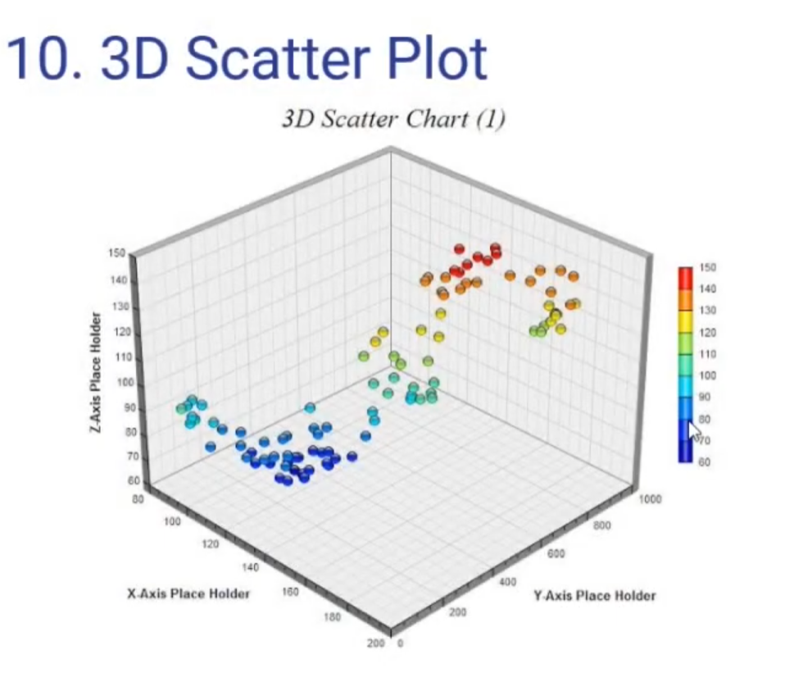

Slide 23
Advantages
Helps You Know Your Data:
EDA lets you see what your data looks like, understand its structure, and notice any patterns or trends. It's like getting to know the data before you work with it.
Finds Problems Early:
It helps you spot issues like missing data, errors, or unusual values early on. This way, you can fix these problems before they cause trouble in your analysis.

Slide 24
Guides Your Next Steps:
EDA gives you ideas about what analysis or models might work best for your data. It points you in the right direction, making the next steps easier.
Visualizes Data Easily:
EDA often involves creating simple charts or graphs that make it easier to understand and explain your data.

Slide 25
Disadvantages
Can Be Time-Consuming:
EDA can take a lot of time, especially if your data is large or complex. You may need to try different ways of looking at the data to fully understand it.
Subjective Results:
Different people might interpret the same data differently during EDA. This means the insights you gain can be influenced by who is doing the analysis.

Slide 26
Doesn’t Provide Final Answers:
EDA is just a starting point. It gives you insights but not the final conclusions. You’ll need to do more detailed analysis to get solid results.
Risk of Over interpreting:
There’s a chance you might see patterns that aren’t really important and try to make them fit into your analysis, leading to incorrect conclusions.

Slide 27
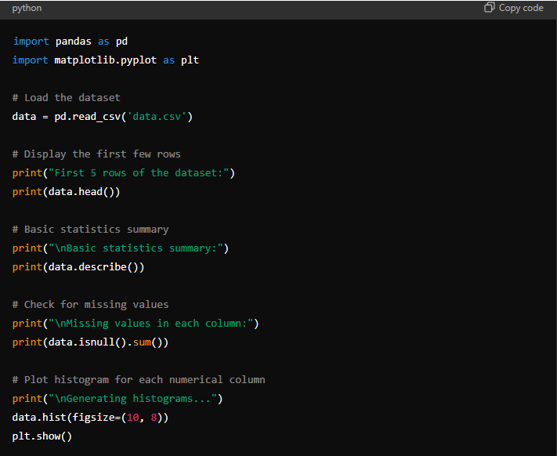

Slide 28
Load the Data: Reads the data from a CSV file into a DataFrame.
View First 5 Rows: Displays the first 5 rows to give a quick look at the dataset.
Basic Statistics: Provides a summary of statistics like mean, min, max, and quartiles for numerical columns.
Missing Values: Checks for any missing values in each column.
Histograms: Plots histograms for each numerical column to visualize their distributions

